Slide 1
Digit
Dynamic Programming
By
Rachit Bundela Priya Jain Sachin Hegde

Slide 2
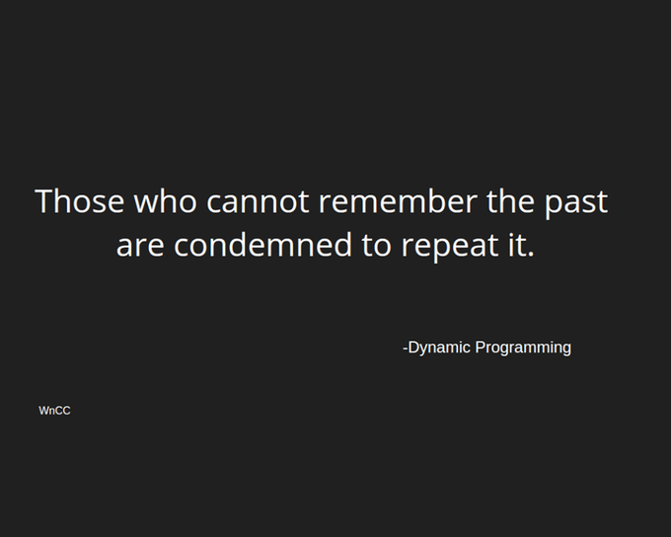

Slide 3
DYNAMIC PROGRAMMING | Introduction
Dynamic Programming is mainly an optimization over plain recursion. Wherever we see a recursive solution that has repeated calls for same inputs, we can optimize it using Dynamic Programming.
The idea is to simply store the results of subproblems, so that we do not have to re-compute them when needed later.
This simple optimization reduces time complexities from exponential to polynomial.

Slide 4
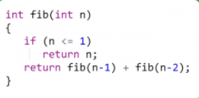
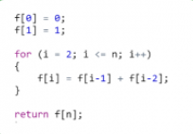
Recursion :Exponential
Dynamic Programming:Linear

Slide 5
Elements Of Dynamic Programming
Simple subproblems – We should be able to break the original problem to smaller subproblems that have the same structure.
Optimal substructure of the problems – The optimal solution to the problem contains within optimal solutions to its subproblems.
Overlapping subproblems – there exist some places where we solve the same subproblem more than once.

Slide 6
How to solve a Dynamic Programming Problem ?
Steps to solve a DP:
Identify if it is a DP problem
Decide a state expression with least parameters
Formulate state relationship
Do tabulation (or add memoization)

Slide 7
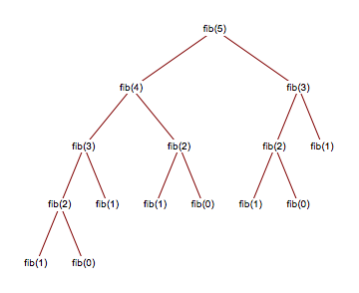
FIBONACCI NUMBERS
The Fibonacci numbers are the numbers in the following integer sequence.
Recurrence Relation: Fn = Fn-1 + Fn-2
F0 = 0 and F1 = 1.
We keep calculating the value over and
over again.

Slide 8
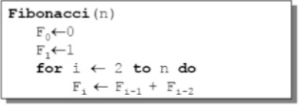
Fibonacci Number
• We can calculate Fn in linear time by remembering solutions to the solved subproblems – dynamic programming
• Compute solution in a bottom-up fashion
• In this case, only two values need to be remembered at any time

Slide 9
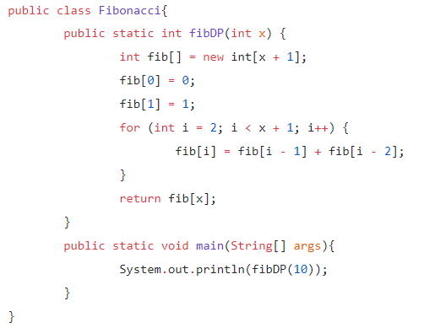
Bottom -Up Approach

Slide 10
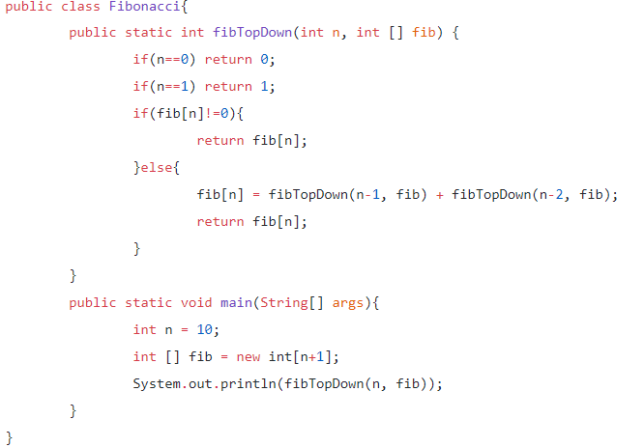
Top-Down Approach

Slide 11
Tabulation - Bottom Up Dynamic Programming
As the name itself suggests starting from the bottom and cumilating answers to the top. Let’s discuss in terms of state transition.
Let’s describe a state for our DP problem to be dp[x] with dp[0] as base state and dp[n] as our destination state. So, we need to find the value of destination state i.e dp[n].
If we start our transition from our base state i.e dp[0] and follow our state transition relation to reach our destination state dp[n], we call it Bottom Up approach as it is quite clear that we started our transition from the bottom base state and reached the top most desired state.

Slide 12
Memorization - Top Down Dynamic Programming
If we need to find the value for some state say dp[n] and instead of starting from the base state that i.e dp[0] we ask our answer from the states that can reach the destination state dp[n] following the state transition relation, then it is the top-down fashion of DP.
Here, we start our journey from the top most destination state and compute its answer by taking in count the values of states that can reach the destination state, till we reach the bottom most base state.

Slide 13
Digit DP | Introduction
There are many types of problems that ask to count the number of integers ‘x’ between two integers say ‘a’ and ‘b’ such that x satisfies a specific property that can be related to its digits.
So, if we say G(x) tells the number of such integers between 1 to x (inclusively), then the number of such integers between a and b can be given by G(b) – G(a-1). This is when Digit DP (Dynamic Programming) comes into action. All such integer counting problems that satisfy the above property can be solved by digit DP approach

Slide 14

Why Digit DP
The First problem that we need to solve is how to get integers which satisfy the given range. suppose our range is from 10^6 to 10^18. One solution is to loop from 10^6 to 10^18 and evaluate each integer but it will require operations in order of 10^18 which is not possible to evaluate in 1 second. So let's think of an alternative.

Slide 15

Digit DP
Let's consider our final solution as F ( L , R ) . Let's break this function into two parts F( L , R ) = F( R , 0 ) – F ( L – 1 , 0 )
yipee! now we don’t have to worry about the left boundary as it is always zero. We just need to get our right limits right and we are done for this part.

Slide 16
Key Concept
Let given number x has n digits. The main idea of digit DP is to first represent the digits as an array of digits t[]. Let’s say a we have tntn-1tn-2 … t2t1 as the decimal representation where ti (0 < i <= n) tells the i-th digit from the right. The leftmost digit tn is the most significant digit.
Now, after representing the given number this way we generate the numbers less than the given number and simultaneously calculate using DP, if the number satisfy the given property. We start generating integers having number of digits = 1 and then till number of digits = n. Integers having less number of digits than n can be analyzed by setting the leftmost digits to be zero.

Slide 17
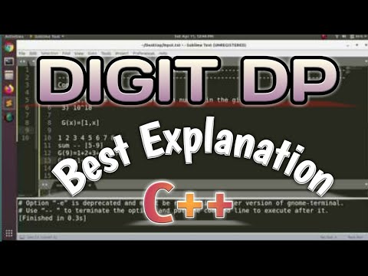
Explanation with Example*
Note*: video is little lengthy but it's a good explanation of digt dp.

Slide 18
Example of Digit DP
Given an Integer N, and a number K, the task is to find out the total numbers from 0 to N which have exactly K non zero digits and the sum of those digits should be odd and that sum should be distinct. The number N can be as large as 10^18.
Example:
Input : N = 10, K = 1
Output : 5
The numbers which follow the conditions are ->
1, 3, 5, 7 and 9
The digit sum of 10 that is (1+0) = 1 is also odd, but 1 is already included in our count.

Slide 19
Example of DDP cont...
We can use Dynamic Programming and it’s very useful technique that is digit-dp to solve this problem.
So instead of keeping a record of non-zero integers, we keep a record of zeroes we can keep at different indices, idx in variable K. The number of zeros, we can keep can be found initially by subtracting K with the number of digits in N.
We keep all the digits of N into a vector say, digits.
Now, we calculate range of elements we can keep at idx by analysing K.
Suppose at idx, we are left with K = 1 (A Non-zero value), then our range to put elements is [0, j] where j is the upper bound decided by the tight value obtained from the current index of the digit from vector digits.
If at idx, we are left with K = 0, then our range becomes [1, j] because we can’t put in 0 there.

Slide 20
Example of DDP cont...
Now, also take a parameter that is sum, which will calculate the sum of digits of a number till the base case hits successfully.
Also, a boolean map is used which will store all the odd sums calculated already, so it gives distinct odd sums.
The recurrence will be:
where j = digits[idx] if tight = 0, else j=9
Base Case:
When idx = digits.size(), K == 0 and sum is odd.
We mark the sum as true and return 1 else return 0.
If idx > digits.size() then return 0.
So we create a DP table say DP[idx][K][tight][sum] which will store our result.

Slide 21


